Slide 1

PROCEDURAL LANGUAGE INTRO TO STORED PROGRAMS
PROF. ARFAOUI

Slide 2
WHAT IS A STORED PROGRAM?
A stored program → a stored module or a stored routine
It is a computer program (a series of instructions associated with a name) that is stored within, and executes within, the database server.
The source code and (sometimes) any compiled version of the stored program are almost always held within the database server’s system tables as well.
When the program is executed, it is executed within the memory address of a database server process or thread.

Slide 3
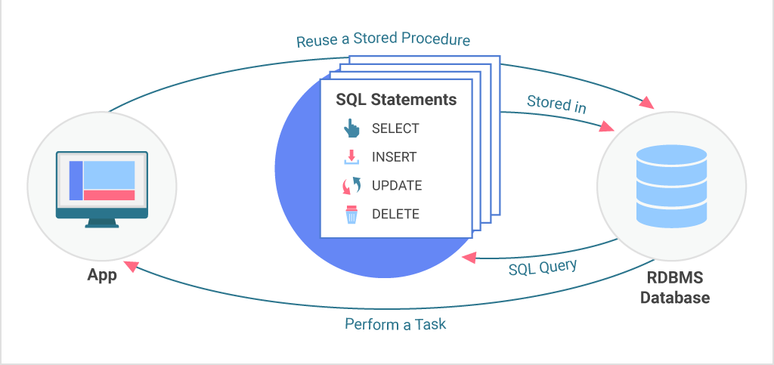
WHAT IS A STORED PROGRAM?
Client
Database server

Slide 4
MAJOR TYPES OF
MYSQL STORED PROGRAMS
Stored Procedures
  Blocks of code stored in the database that are pre-compiled.
  They can operate on the tables within the database and return scalars or results sets.
Stored Functions
  Can be used like a built-in function to provide expanded capability to your SQL statements.
  They can take any number of arguments and return a single value.
Triggers
  Kick off in response to standard database operations on a specified table.
  Can be used to automatically perform additional database operations when the triggering event occurs.

Slide 5
WHY USE STORED PROGRAMS?
More secure database.
Improve the maintainability of your code as underlying data structures evolve.
Reduce network traffic.
Implement common routines accessible from multiple applications
Improve the portability of your application.

Slide 6
WHY USE STORED PROGRAMS?
The bottom line:
  stored programs—procedures, functions, and triggers—can improve the performance, security, maintainability, and reliability of your applications

Slide 7
STORED PROCEDURES IN MYSQL
A stored procedure contains a sequence of SQL commands stored in the database catalog so that it can be invoked later by a program
Stored procedures are declared using the following syntax:
  Create Procedure <proc-name> (param₁, param₂, …, param_{n} )
  begin
  -- SQL statements
  end;
  where each param is of the form:
  [in | out | inout] <param_name> <param_type>
  in mode: allows you to pass values into the procedure,
  out mode: allows you to pass value back from procedure to the calling program

Slide 8
OUR FIRST STORED PROCEDURE
    DELIMITER $$
    CREATE PROCEDURE simpleProc()
    BEGIN
    SELECT * FROM authors;
    END$$
    CALL simpleProc()$$
Creating the procedure
Executing the procedure

Slide 9
EXPLANATION
Issue the DELIMITER command to set '$$' as the end of a statement.
The CREATE PROCEDURE statement indicates the start of a stored procedure definition. Note that the stored procedure name “simpleProc" is followed by an empty set of parentheses "( )". If our stored procedure had any parameters, they would be defined within these parentheses. This stored procedure has no parameters, but we need to include the parentheses anyway, or we will get a syntax error.
The BEGIN statement indicates the start of the stored procedure program. All stored programs with more than a single statement must have at least one BEGIN and END block that defines the start and end of the stored program.
SELECT statement that returns a result set to the calling program.
The END statement terminates the stored procedure definition. Note that we ended the stored procedure definition with $$ so that MySQL knows that we have completed the CREATE PROCEDURE statement

Slide 10
MORE ABOUT STORED PROCEDURES
You can declare variables in stored procedures
Can have any number of parameters.
Each parameter has to specify whether it’s in, out, or inout.
  The typical argument list will look like
  (out ver_param varchar(25), inout incr_param int …)
  Be careful of output parameters for side effects.
Your varchar declarations for the parameters have to specify the maximum length.
The individual parameters can have any supported MySQL datatype.
They can be called using the call command, followed by the procedure name, and the arguments.
You can use flow control statements:
(conditional IF-THEN-ELSE or loops such as WHILE and REPEAT)

Slide 11

STORED PROCEDURE WITH A PARAMETER
    DELIMITER $$
    DROP PROCEDURE IF EXISTS sqrtProc$$
    CREATE PROCEDURE sqrtProc(inputNum INT)
    BEGIN
    DECLARE sqrtVal FLOAT;
    SET sqrtVal = SQRT(inputNum);
    SELECT sqrtVal;
    END$$
    DELIMITER ;
    CALL sqrtProc(5);

Slide 12

STORED PROCEDURE WITH A PARAMETER
    DELIMITER $$
    DROP PROCEDURE IF EXISTS sqrtProc$$
    CREATE PROCEDURE sqrtProc(inputNum INT, OUT sqrtVal FLOAT)
    BEGIN
    SET sqrtVal = SQRT(inputNum);
    END$$
    DELIMITER ;
    CALL sqrtProc(5, @outValue);
    SELECT @outValue;

Slide 13
CONDITIONS AND HANDLERS
A condition is somewhat like an exception.
A handler is somewhat like the catch block in a try/catch construct.
  The “canned” conditions that MySQL has will prove to be enough for our purposes.
  We should be able to get by with just a few conditions, we’ll see as we go along.

Slide 14
IF STATEMENTS
IF blocks have the following syntax:
    IF <condition> then
      <statements>
    ELSEIF <condition> then
      <statements>
    ELSE
      <statements>
    END IF
Note the annoying syntax: END IF has an embedded blank, ELSEIF does not.
There can be any number of ELSIF clauses in your IF statement.

Slide 15
CASE STATEMENT
Two different syntaxes:
CASE <expression>
  WHEN <value> then
    <statements>
  WHEN <value> then
    <statements>
  …
  ELSE
    <statements>
END CASE;
CASE
  WHEN <condition> then
    <statements>
  WHEN <condition> then
    <statements>
  …
  ELSE
    <statements>
END CASE;

Slide 16

STORED PROCEDURE
CONDITIONAL EXECUTION
    DELIMITER $$
    DROP PROCEDURE IF EXISTS discuntedPrice$$
    CREATE PROCEDURE discountedPrice(regPrice NUMERIC(8,2),
    OUT discPrice NUMERIC(8,2))
    BEGIN
    IF (regPrice > 500) THEN
    SET discPrice = regPrice * 0.8;
    ELSEIF (regPrice > 100) THEN
    SET discPrice = regPrice * 0.9;
    ELSE
    SET discPrice = regPrice;
    END IF;
    END$$
    DELIMITER ;
    CALL discountedPrice(300,@newPrice);
    SELECT @newPrice;

Slide 17
LOOPS
Loops allow stored programs to execute statements repetitively. The MySQL stored program language offers three types of loops:
Simple loops using the LOOP and END LOOP clauses
Loops that continue while a condition is true, using the WHILE and END WHILE clauses
Loops that continue until a condition is true, using the REPEAT and UNTIL clauses
With all three loop types, you terminate execution of the loop with the LEAVE statement.

Slide 18
LOOPING
    [begin_label:] LOOP
      <statement list>
    END LOOP [end_label]
    Note that the end_label has to = the begin_label
    Both are optional
    [begin_label:] REPEAT
      <statement list>
    UNTIL <search_condition>
    END REPEAT [end_label]

Slide 19

REPEAT UNTIL EXAMPLE
DELIMITER //
DROP PROCEDURE IF EXISTS LoopDemo//
CREATE PROCEDURE LoopDemo()
BEGIN
DECLARE x INT;
DECLARE str VARCHAR(255);
SET x = 1;
SET str = '';
loop_label: LOOP
IF x > 10 THEN
LEAVE loop_label;
END IF;
SET x = x + 1;
IF (x mod 2) THEN
ITERATE loop_label;
ELSE
SET str = CONCAT(str,x,',');
END IF;
END LOOP;
SELECT str;
END//
DELIMITER ;
CALL LoopDemo();

Slide 20
NOTES ON THE PREVIOUS EXAMPLE
The DELIMITER // statement sets a session variable so that the // becomes the statement terminator.
For the purposes of that session, the “;” within the stored procedure are just like any other character.
When the stored procedure is run, however, the “;” function the way that they normally do in MySQL.
You always want to make the delimiter a “;” again when you change it.

Slide 21
WHILE
[begin_label:] WHILE <condition> DO
  <statements>
END WHILE [end_label]

Slide 22
LOOP CONTROL FLOW
Iterate <label> – start the loop again
  Can only be issued within LOOP, REPEAT, or WHILE statements
  Works much like the “continue” statement in Java or C++.
Leave <label> – jumps out of the control construct that has the given label.
  Can only be issued within LOOP, REPEAT, or WHILE statements, just like the iterate statement.
  You can use this at any level of nesting, → you can jump out to the out of the outermost loop if you desire.

Slide 23
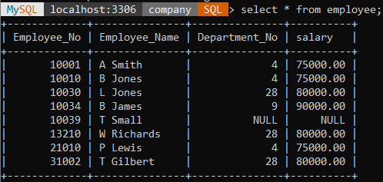
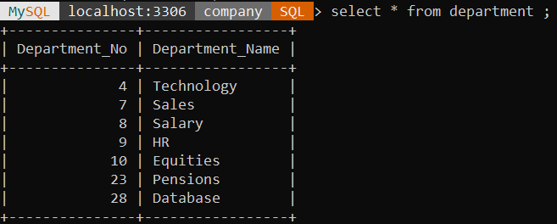

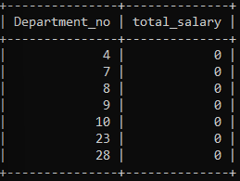
EXAMPLE
Suppose we want to keep track of the total salaries of employees working for each department.
We will create the deptSal table as follows:
We need to write a procedure to update the salaries in
the deptsal table

Slide 24
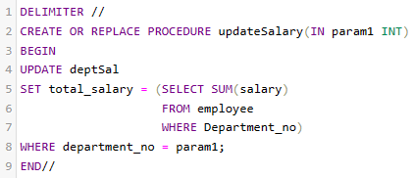
EXAMPLE – STEP 1
Step 1: Change the delimiter (i.e., terminating character) of SQL statement from semicolon (;) to something else (e.g., //) So that you can distinguish between the semicolon of the SQL statements in the procedure and the terminating character of the procedure definition

Slide 25
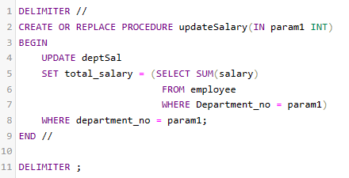
EXAMPLE – STEP 2
Step 2:
Define a procedure called updateSalary which takes as input a department number.
The body of the procedure is an SQL command to update the totalsalary column of the deptsal table.
Terminate the procedure definition using the delimiter you had defined in step 1 (//)

Slide 26
EXAMPLE – STEP 3
Step 3: Change the delimiter back to semicolon (;)

Slide 27
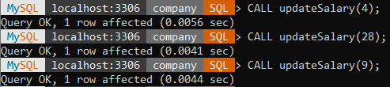
EXAMPLE – STEP 4
Step 4: Call the procedure to update the totalsalary for each department

Slide 28
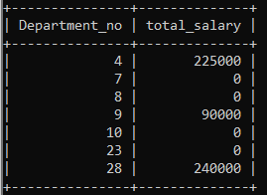
EXAMPLE – STEP 5
Step 5: Show the updated total salary in the deptsal table
Before procedure CALL after procedure CALL

Slide 29
STORED PROCEDURES IN MYSQL
Use show procedure status to display the list of stored procedures you have created:
Use drop procedure to remove a stored procedure

Slide 30
STORED PROCEDURES IN MYSQL
MySQL also supports cursors in stored procedures.
  A cursor is used to iterate through a set of rows returned by a query so that we can process each individual row.
To learn more about stored procedures, go to:
  http://www.mysqltutorial.org/mysql-stored-procedure-tutorial.aspx

Slide 31
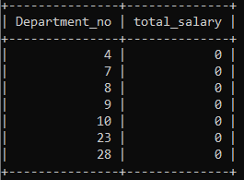
EXAMPLE USING CURSORS
The previous procedure updates one row in deptsal table based on input parameter
Suppose we want to update all the rows in deptsal simultaneously
  First, let’s reset the totalsalary in deptsal to zero

Slide 32
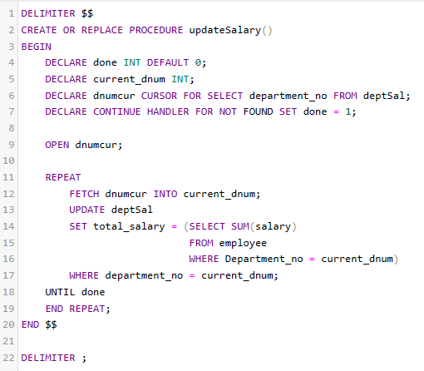
EXAMPLE USING CURSORS – PART 2
Use cursor to iterate the rows

Slide 33
EXAMPLE USING CURSORS – PART 3
Before procedure CALL after procedure CALL

Slide 34
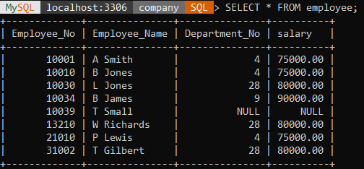
ANOTHER EXAMPLE
Create a procedure to give a raise to all employees

Slide 35
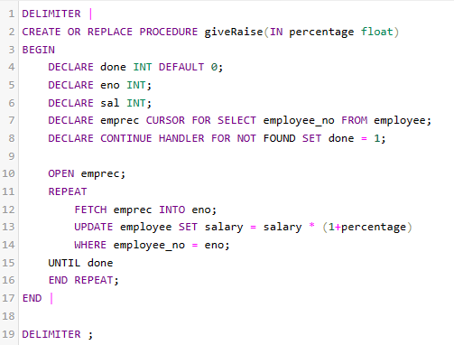
ANOTHER EXAMPLE – PART 2

Slide 36
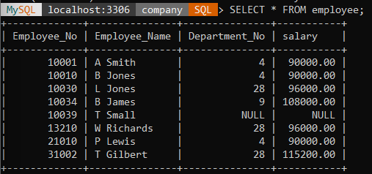
ANOTHER EXAMPLE – PART 3

Slide 37
FUNCTIONS

Slide 38
FUNCTIONS
Your user-defined functions can act just like a function defined in the database.
They take arguments and return a single output.
The general syntax is:
create function <name> (<arg1> <type1>, [<arg2> <type2> [,…]) returns <return type> [deterministic]
  Deterministic means that the output from the function is strictly a consequence of the arguments.
  Same values input → same values output.
  Like a static method in Java.
  Note that the arguments cannot be changed and the new values passed back to the caller.
Follow that with begin … end and you have a function.

Slide 39
FUNCTIONS
Functions are declared using the following syntax:
  function <function-name> (param_spec₁, …, param_spec_{k})
  returns <return_type>
  [not] deterministic allow optimization if same output
  for the same input (use RAND not deterministic )
  Begin
  -- execution code
  end;
  where param_spec is:
  [in | out | in out] <param_name> <param_type>

Slide 40
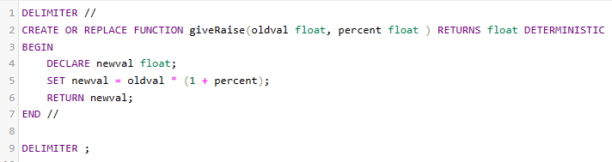
EXAMPLE OF FUNCTIONS

Slide 41
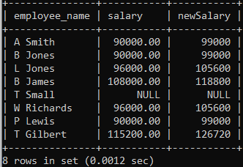
USE OF FUNCTIONS

Slide 42
TRIGGERS

Slide 43
SQL TRIGGERS
To monitor a database and take a corrective action when a condition occurs
  Examples:
    Charge $10 overdraft fee if the balance of an account after a withdrawal transaction is less than $500
    Limit the salary increase of an employee to no more than 5% raise
      CREATE TRIGGER trigger-name
      trigger-time trigger-event
      ON table-name
      FOR EACH ROW
      trigger-action;
        trigger-time ∈ {BEFORE, AFTER}
        trigger-event ∈ {INSERT,DELETE,UPDATE}

Slide 44
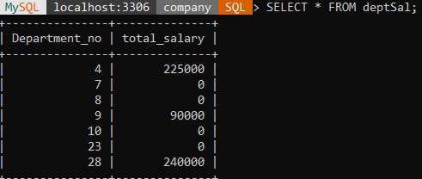
SQL TRIGGERS: AN EXAMPLE
We want to create a trigger to update the total salary of a department when a new employee is hired

Slide 45
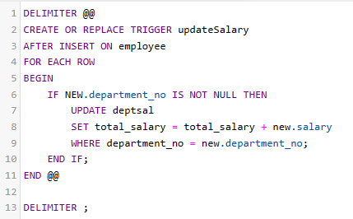
SQL TRIGGERS: ANOTHER EXAMPLE
Create a trigger to update the total salary of a department whenever a new employee is hired:
The keyword “new” refers to the new row inserted

Slide 46
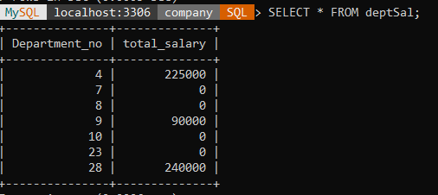
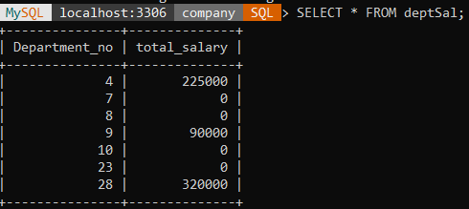
TRIGGERS: ANOTHER EXAMPLE – PART 2
Total Salary increased by 80000
Nothing changes

Slide 47
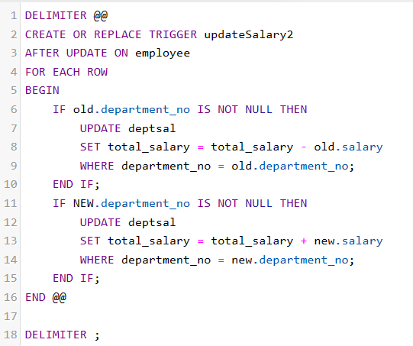
TRIGGERS: ANOTHER EXAMPLE – PART 3
A trigger to update the total salary of a department when an employee tuple is modified:

Slide 48
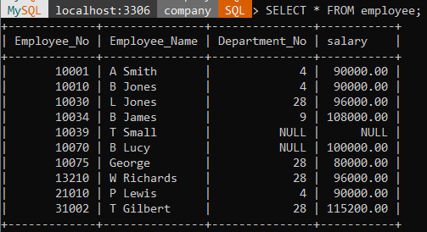
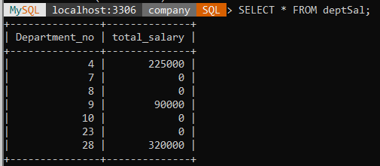

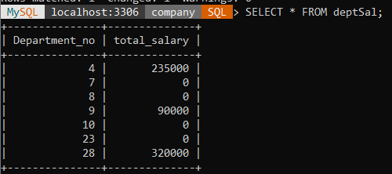
TRIGGERS: AN EXAMPLE – PART 4
Total salary for Technology dept is increases by 10000

Slide 49
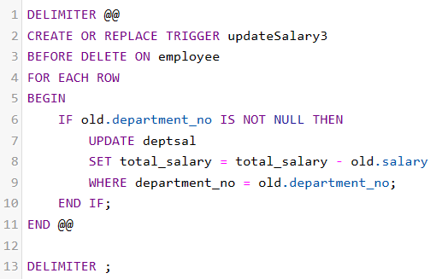
TRIGGERS: AN EXAMPLE – PART 5
A trigger to update the total salary of a department when an employee tuple is deleted:

Slide 50
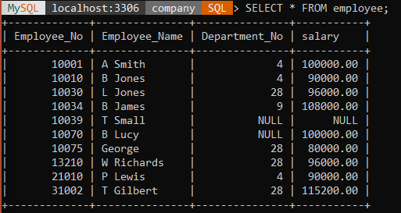
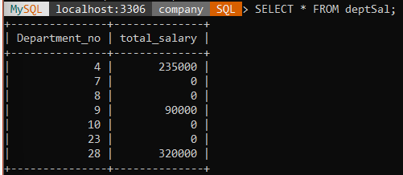
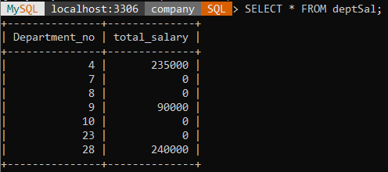
TRIGGERS: AN EXAMPLE – PART 6
Total salary for dept with no 28 is decreased by 80000

Slide 51
A FEW THINGS TO NOTE
A given trigger can only have one event.
If you have the same or similar processing that has to go on during insert and delete, then it’s best to have that in a procedure or function and then call it from the trigger.
A good naming standard for a trigger is <table_name>_event if you have the room for that in the name.
Just like a function or a procedure, the trigger body will need a begin … end unless it is a single statement trigger.

Slide 52
THE SPECIAL POWERS OF A TRIGGER
While in the body of a trigger, there are potentially two sets of column values available to you, with special syntax for denoting them.
  old.<column name> will give you the value of the column before the DML statement executed.
  new.<column name> will give you the value of that column after the DML statement executed.
Insert triggers have no old values available, and delete triggers have no new values available for obvious reasons. Only update triggers have both the old and the new values available.
Only triggers can access these values this way.

